Slide 1

ONLINE FOOD ORDER APP

Slide 2
Problem Statement
J & K FoodCorner is an Online Food ordering website. It is a Single Page Application.
There are two flows in this SPA
User Module
Admin Module
It has products, product details, cart page and feedback form in the user module whereas in admin module admin can add a new food item.

Slide 3

LOGIN PAGE
Initially login page opens up, user or admin can login and use the website. If the user is new to the website, he/she needs to register and then can login.
If the username or password in incorrect, it will validate and show the credentials are invalid.
Password is encrypted in login so that no one can misuse one’s account.

Slide 4
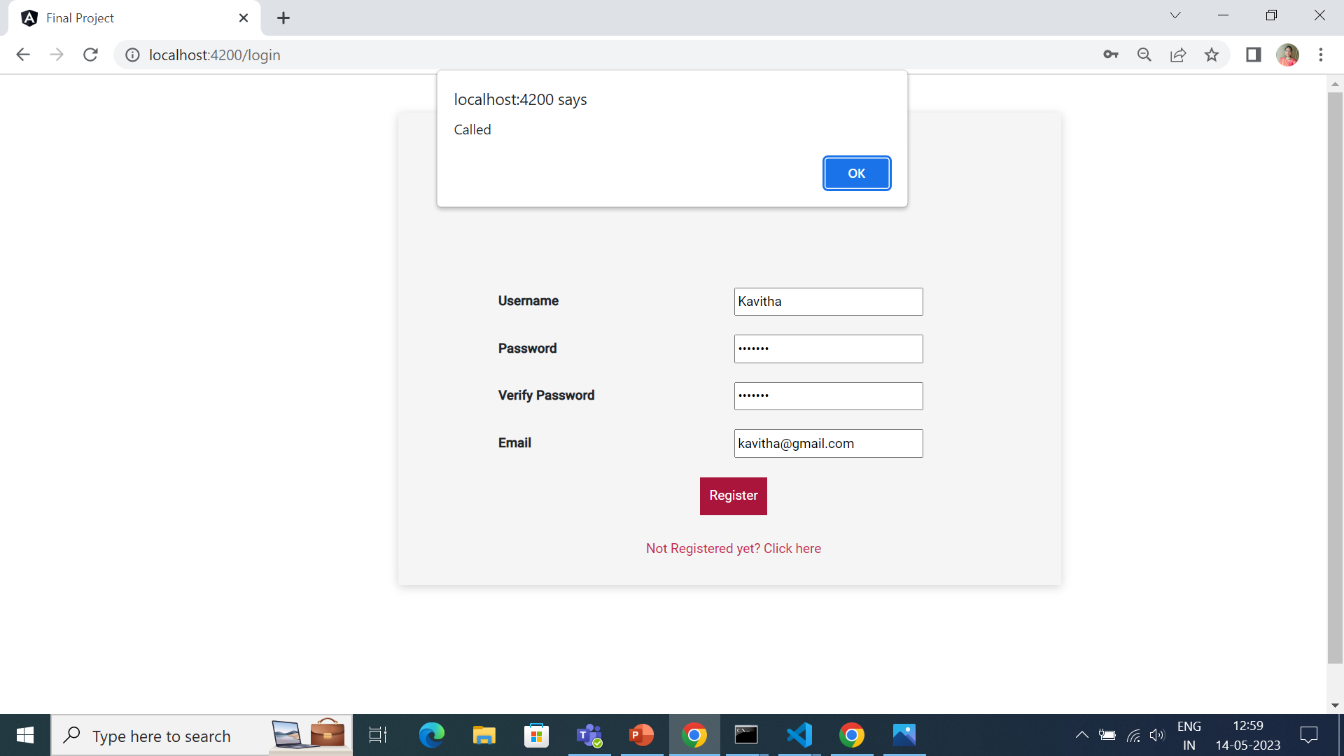

Slide 5


Slide 6
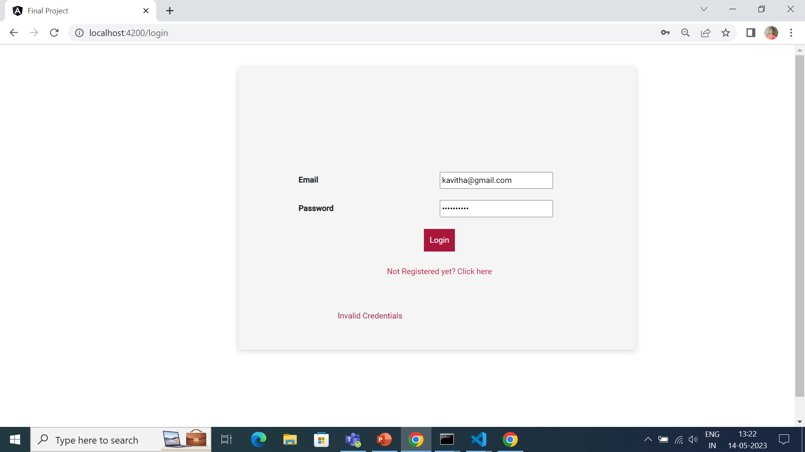

Slide 7


Slide 8
HOME PAGE
In user page user can see all food items and can search for any specific food item.
There are several categories available. User can filter whatever category they want.
User can click any food items to see the detailed information and price about the food and user can add the food to the cart with quantity from the home page and the food item will be added to the cart page.

Slide 9
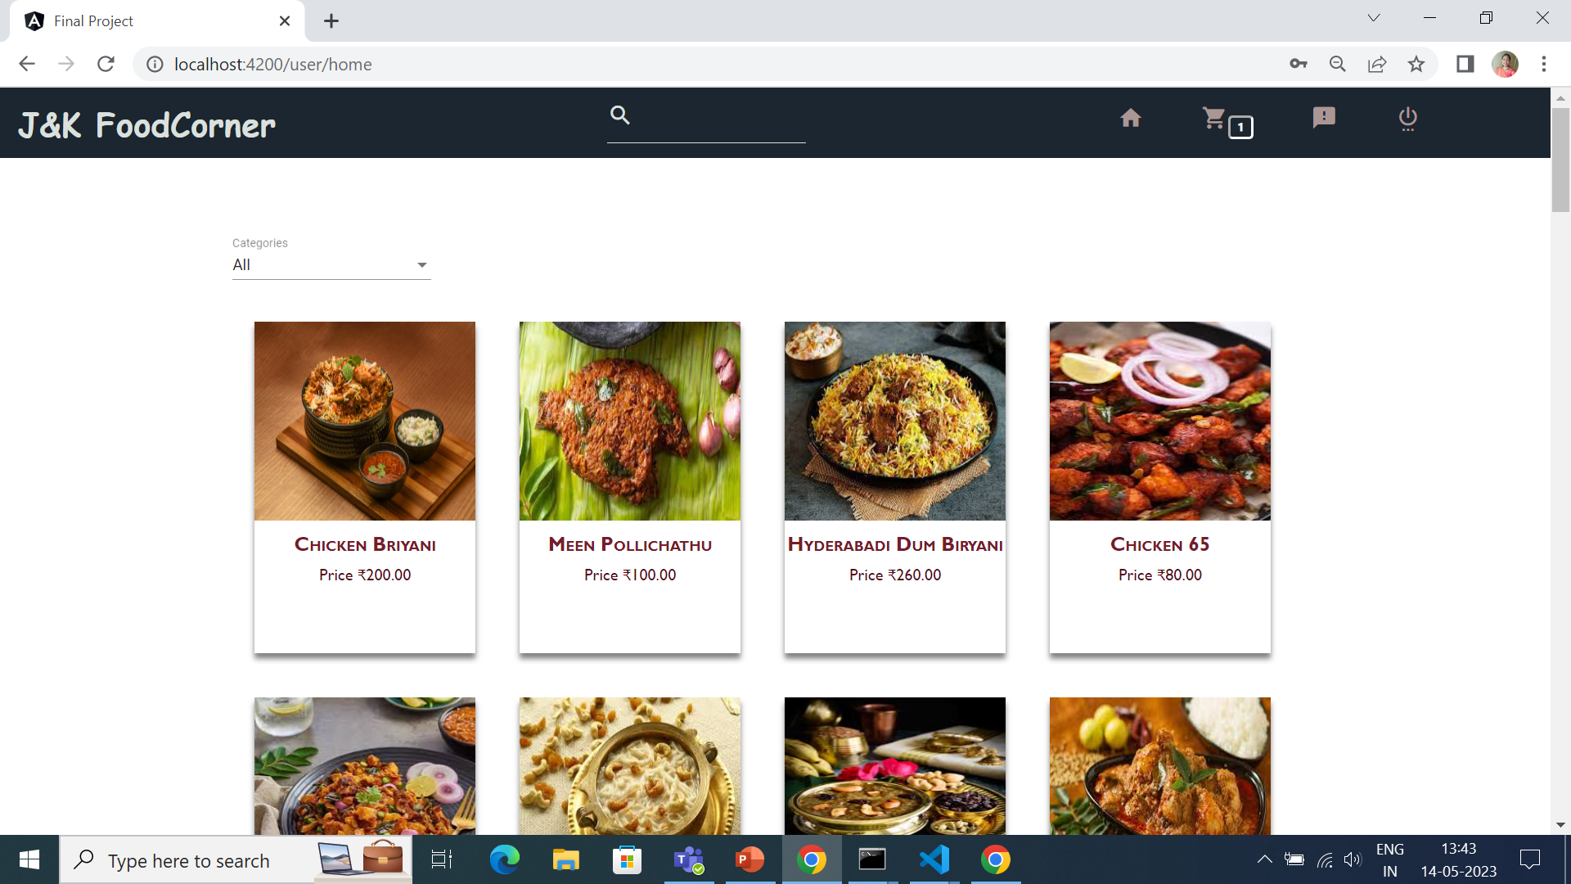

Slide 10
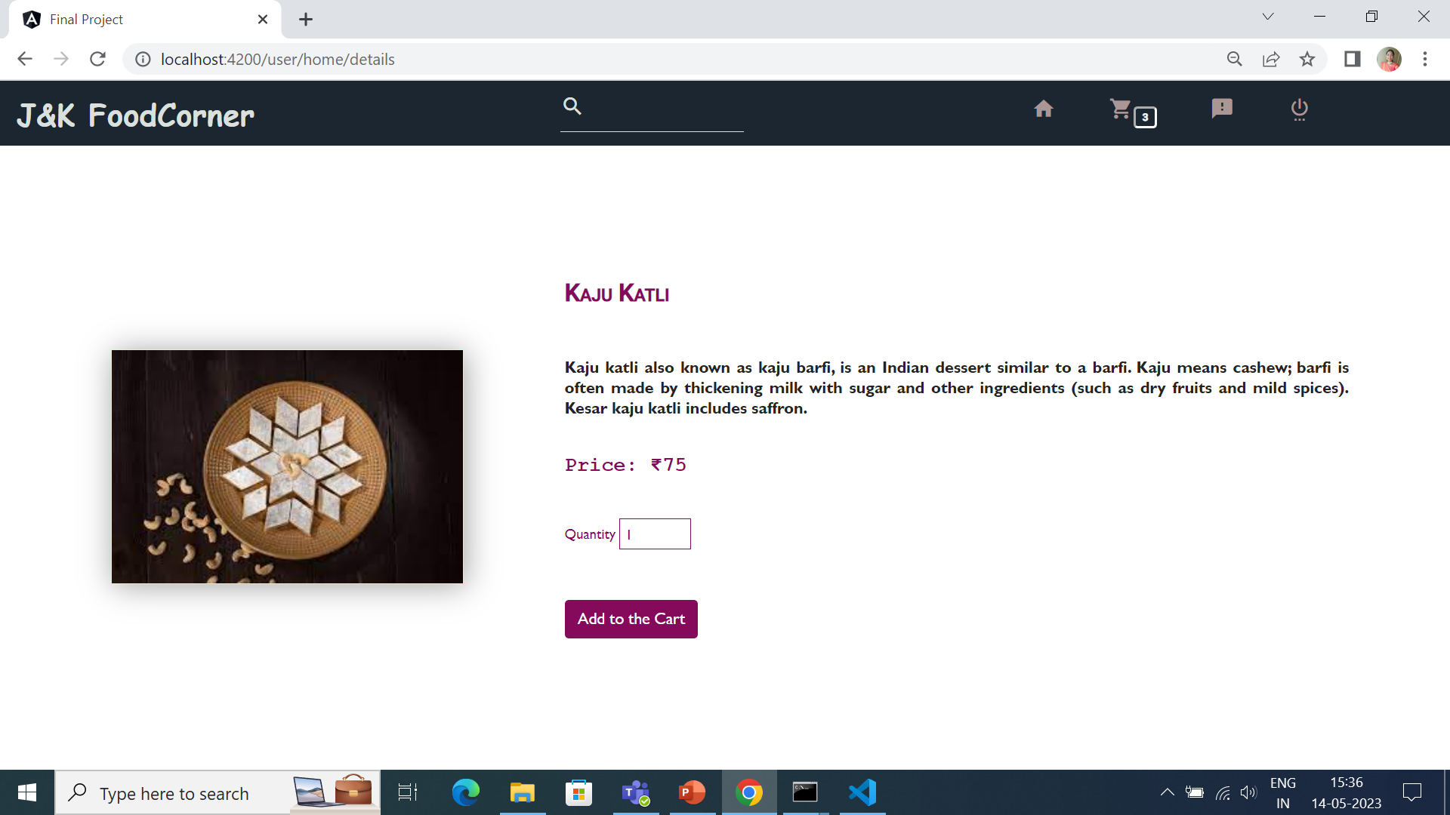

Slide 11

CART PAGE
In cart page user can see the details of the food items they have added from the home page. Count of the cart is also displayed.
Cost of each item will be displayed here. Grand Total is available to ease user's work.
If the user wants to delete a single food item, they can click the delete button and to empty the cart, he/she can click the empty cart button. They can redirect to the home page by clicking continue shopping.
If the cart is empty, it will show the cart is empty continue shopping.

Slide 12
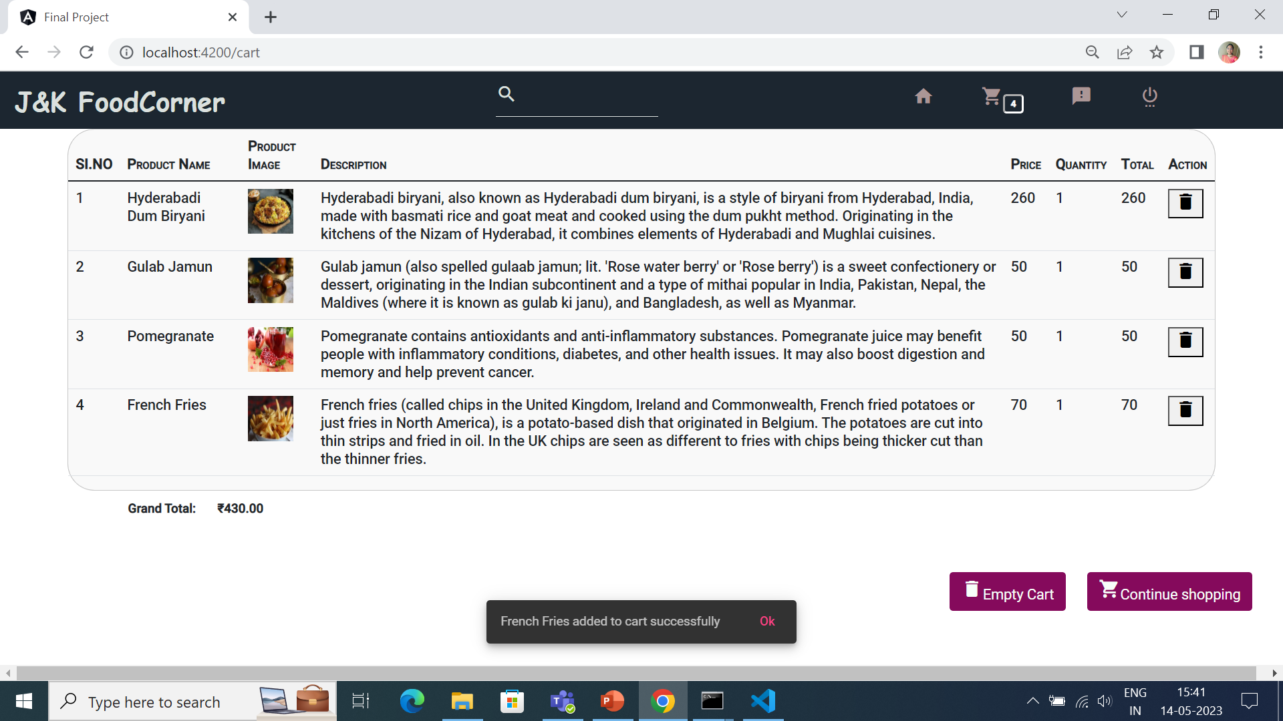

Slide 13
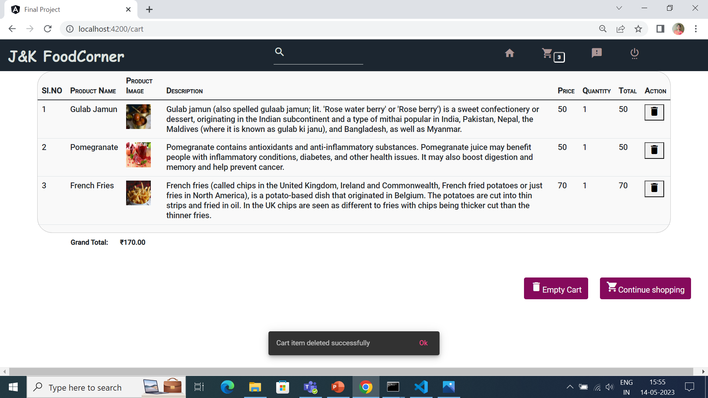

Slide 14
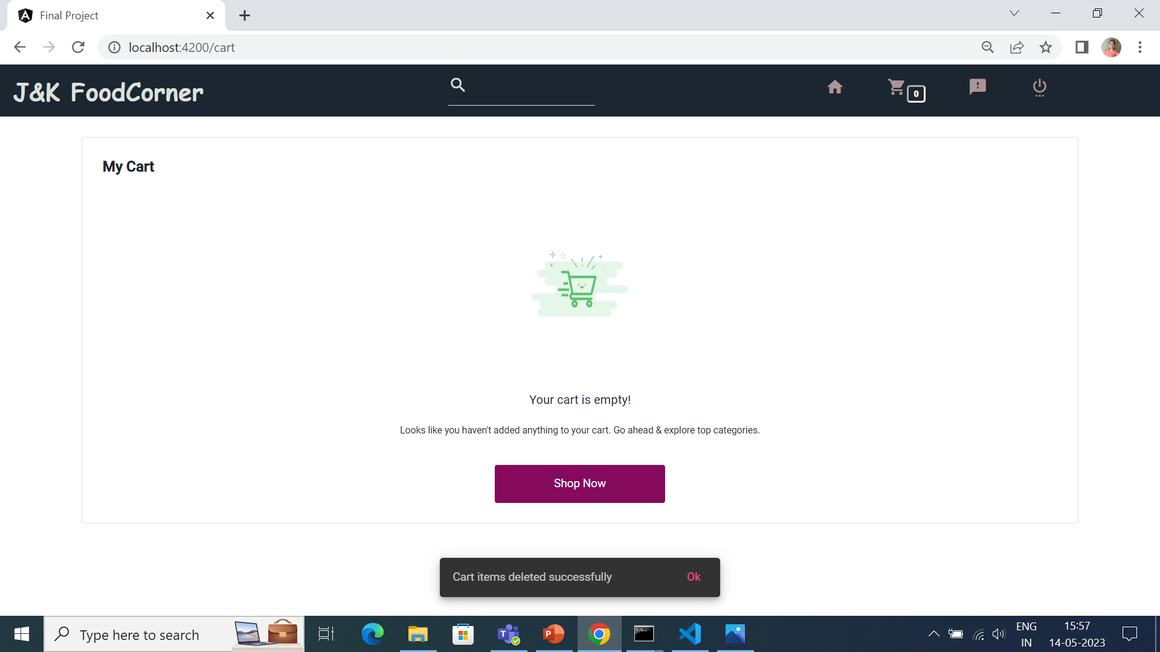

Slide 15
FEEDBACK PAGE
User can share their experience with this website.
The user have to fill the form as per the validations mentioned there. Unless they satisfies the validations, they can’t post their feedback.
Feedbacks will be displayed in the same page. That will be useful for other users.

Slide 16
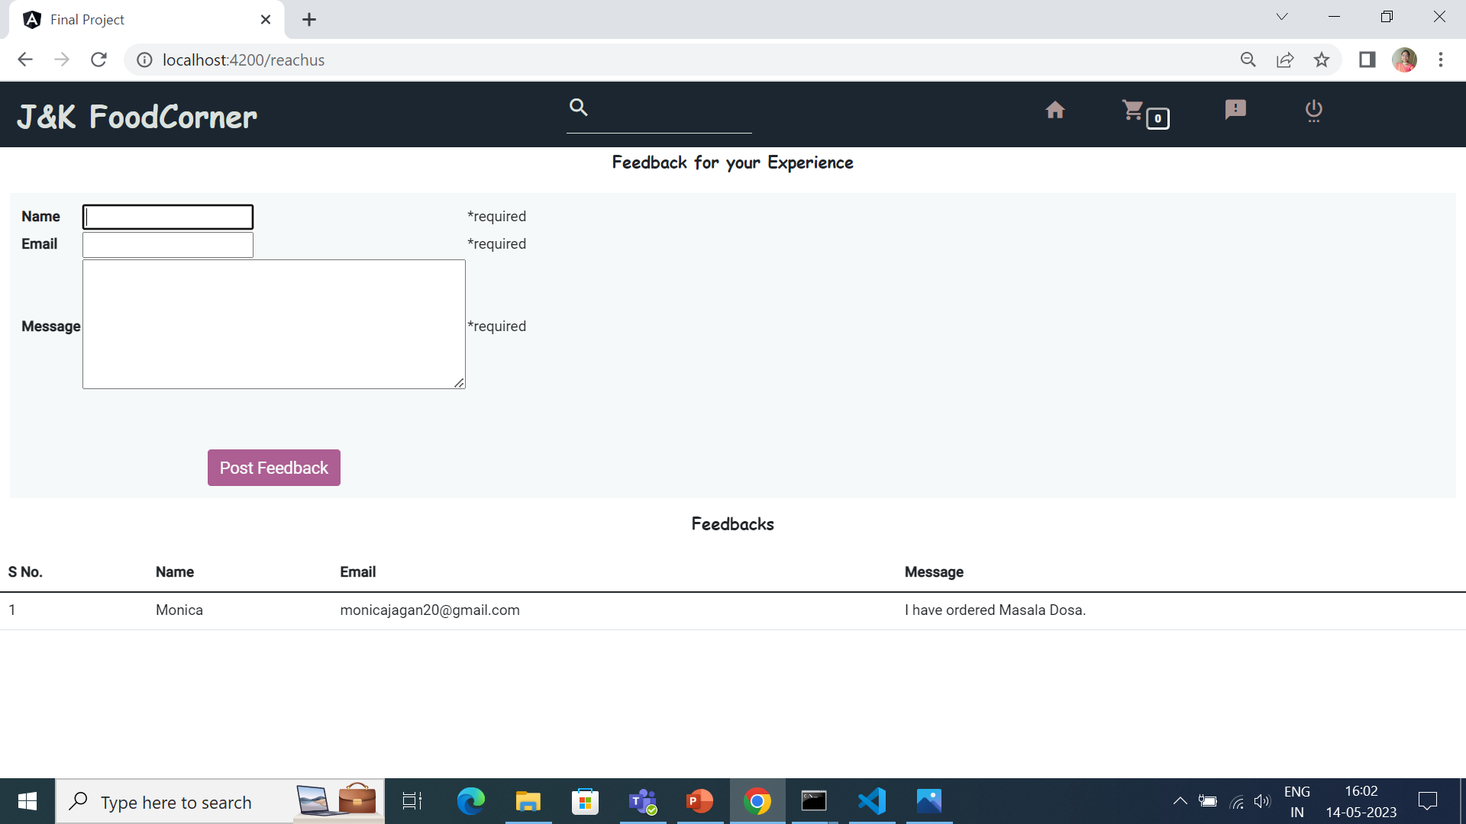

Slide 17
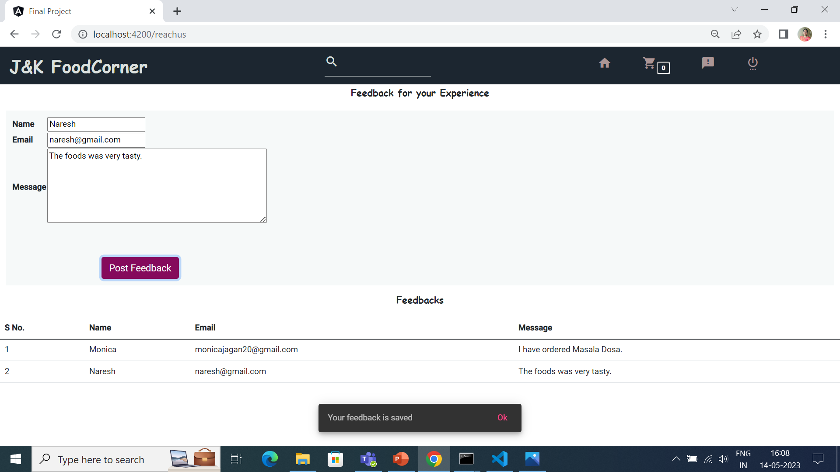

Slide 18
ADMIN PAGE
In admin module, admin can add a new food items and can delete the added item if they want.
Admin can filter any food item.To add a food item admin should fill a form about the food and save it.
The details of added food items will be available in the table format.

Slide 19
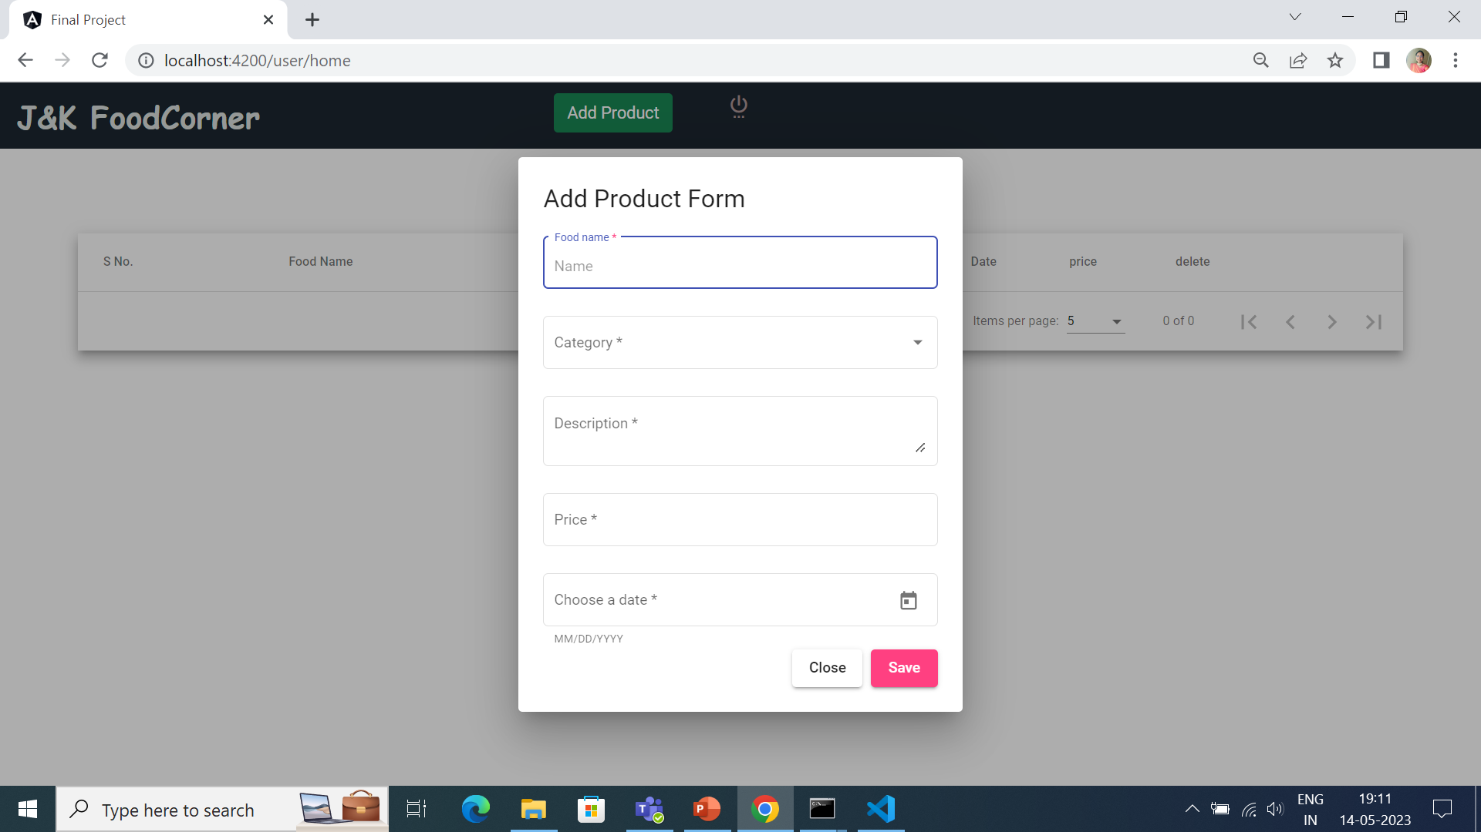

Slide 20
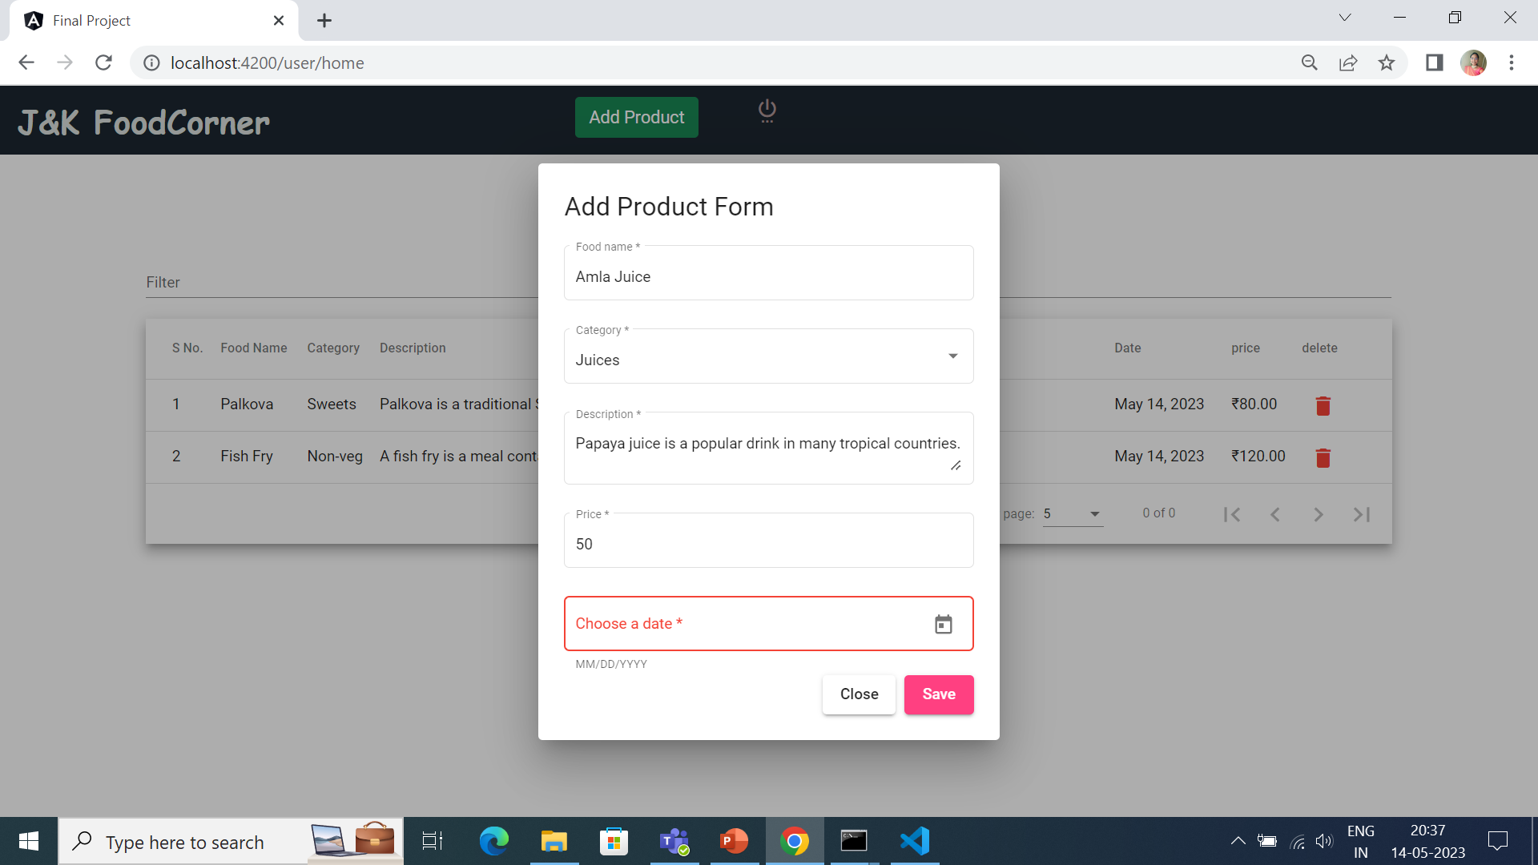

Slide 21
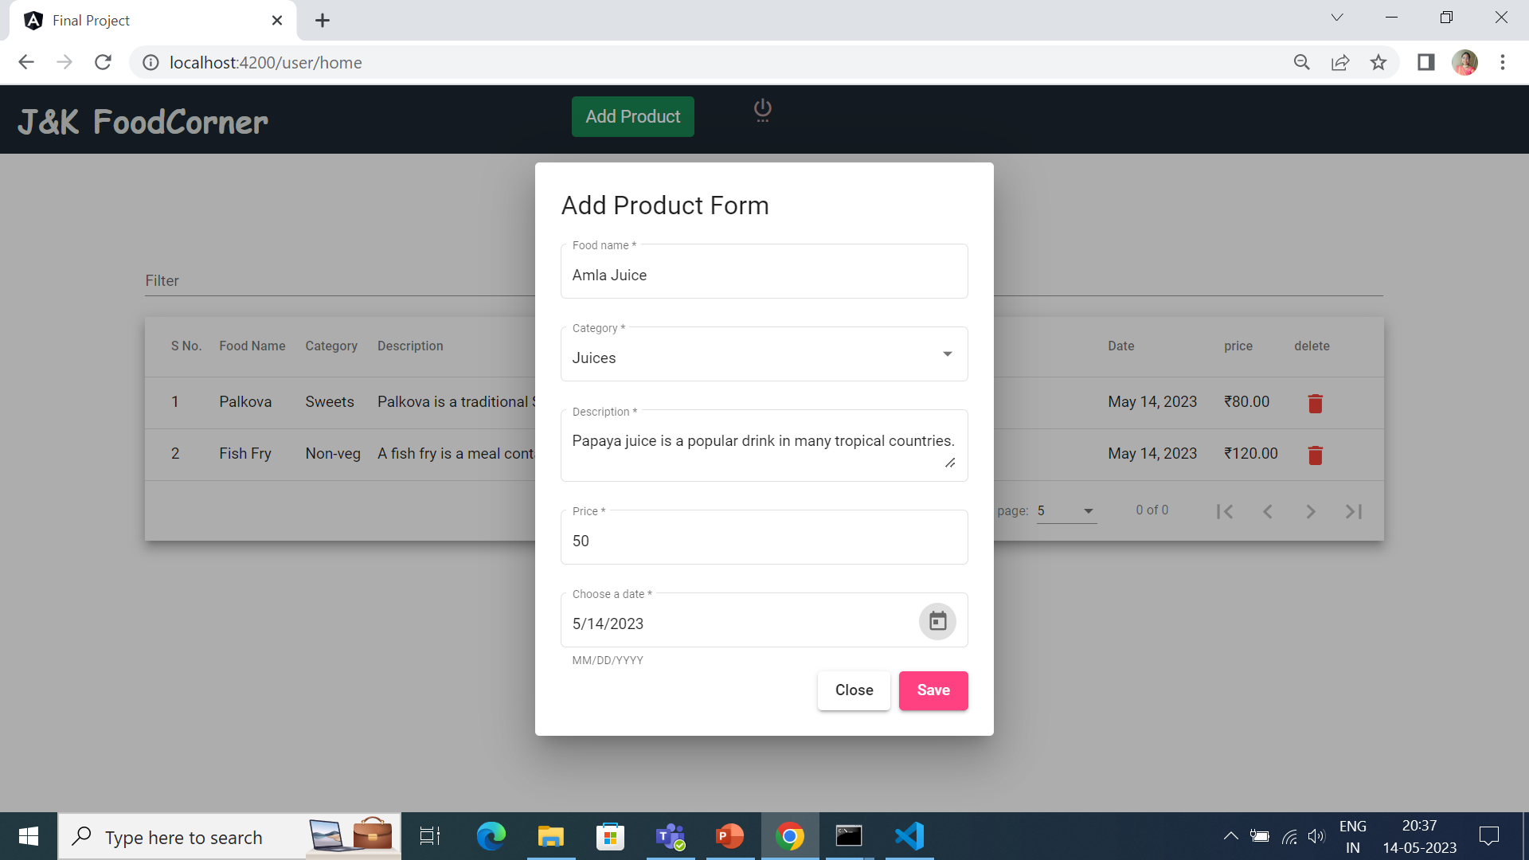

Slide 22
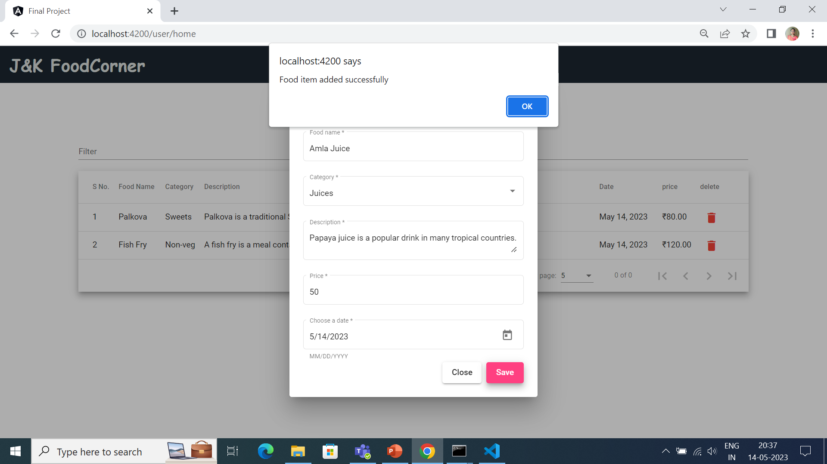

Slide 23
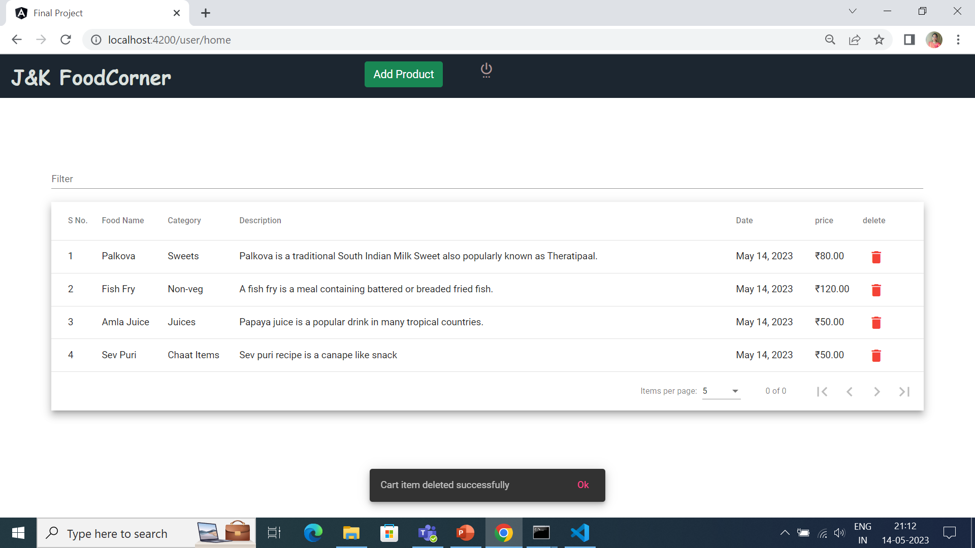

Slide 24
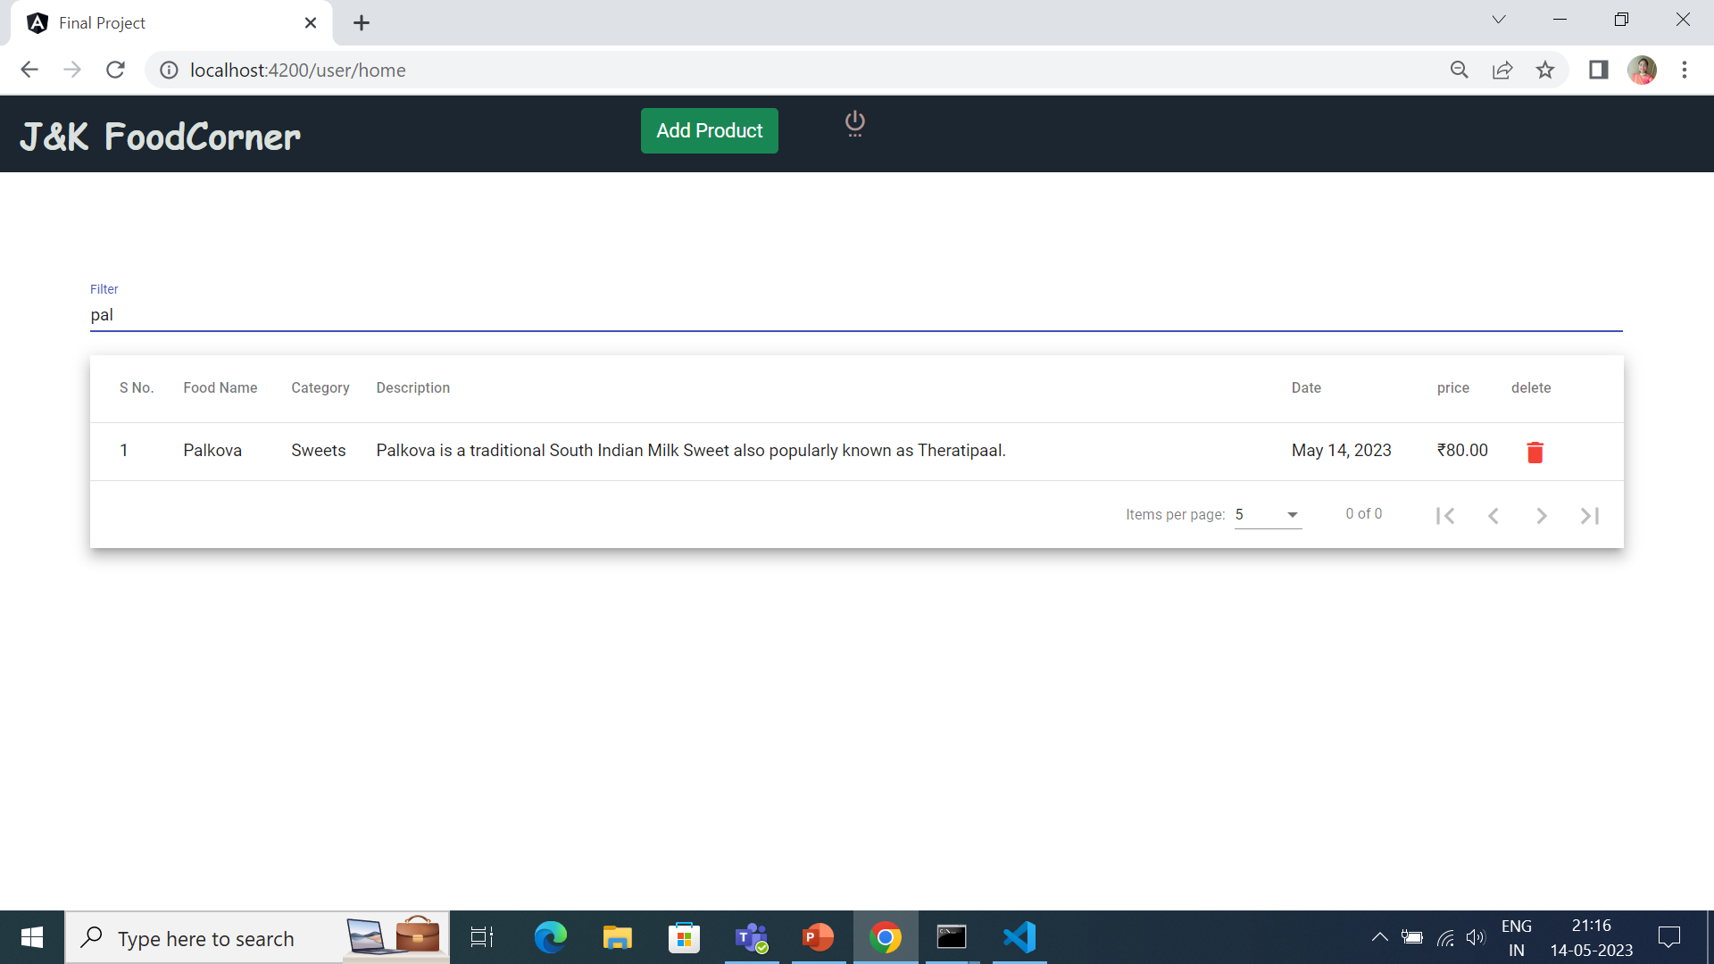

Slide 25
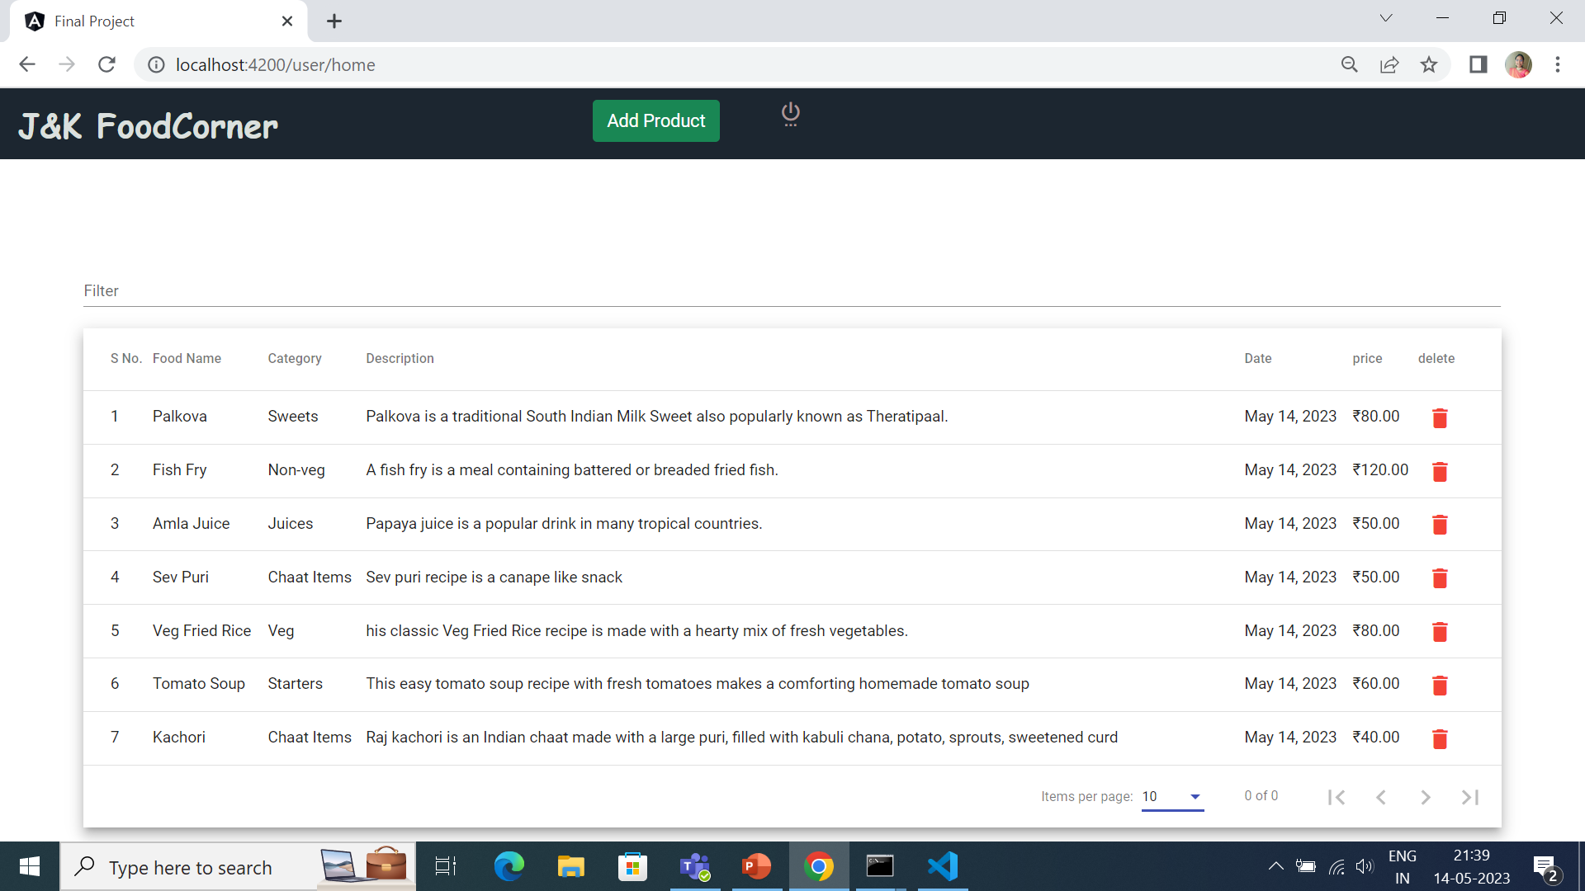

Slide 26
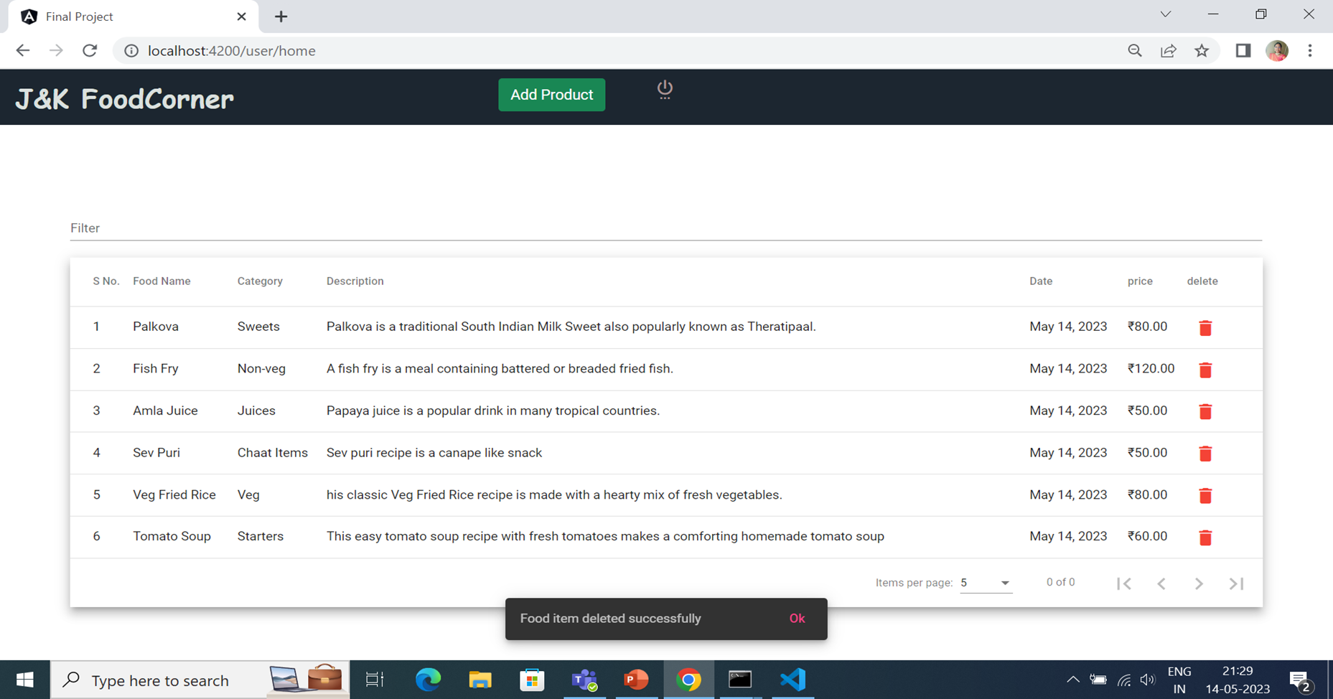

Slide 27


